Slide 1
Secure API Design and Implementation
Kamran Khalid
Senior Backend Developer

Slide 2
Why API Security Matters
APIs = Front Door to modern apps
FinTech = Money, Identity, Trust
Weak security → breaches, GDPR fines, reputation loss

Slide 3
Common API Attacks
BOLA: change /user/123 → /user/124
Broken Authentication: weak JWTs
Token Theft & Replay
Business Logic Abuse

Slide 4
AuthN vs AuthZ
Authentication (AuthN): Who are you?
Authorization (AuthZ): What can you do?
Example: Login vs Role-based Access

Slide 5
OAuth 2.0 & OIDC
OAuth 2.0: Delegated access
OIDC: Authentication layer
Flows: Authorization Code, Client Credentials

Slide 6
JWT — Pros & Pitfalls
Pros: Stateless, scalable, holds claims
Pitfalls: Hard to revoke
Best: Verify signature & expiry

Slide 7
Token Storage & Rotation
Web → HttpOnly cookies
Mobile → Secure storage
Rotation: Use refresh tokens & invalidate old ones

Slide 8
Transport & Network
TLS 1.2/1.3 only
HSTS, mTLS
API Gateway & WAF for rate limiting & filtering

Slide 9
Request-Level Security
Validate input & Content-Type
Parameterized Queries
Sanitize responses to avoid leaks

Slide 10
Rate Limiting & Throttling
Prevents brute-force & abuse
Use token bucket or sliding window
Example: 5 logins / 15 min per IP

Slide 11
Secrets & CI/CD Security
Never hardcode secrets
Use AWS Secrets Manager or Vault

Slide 12

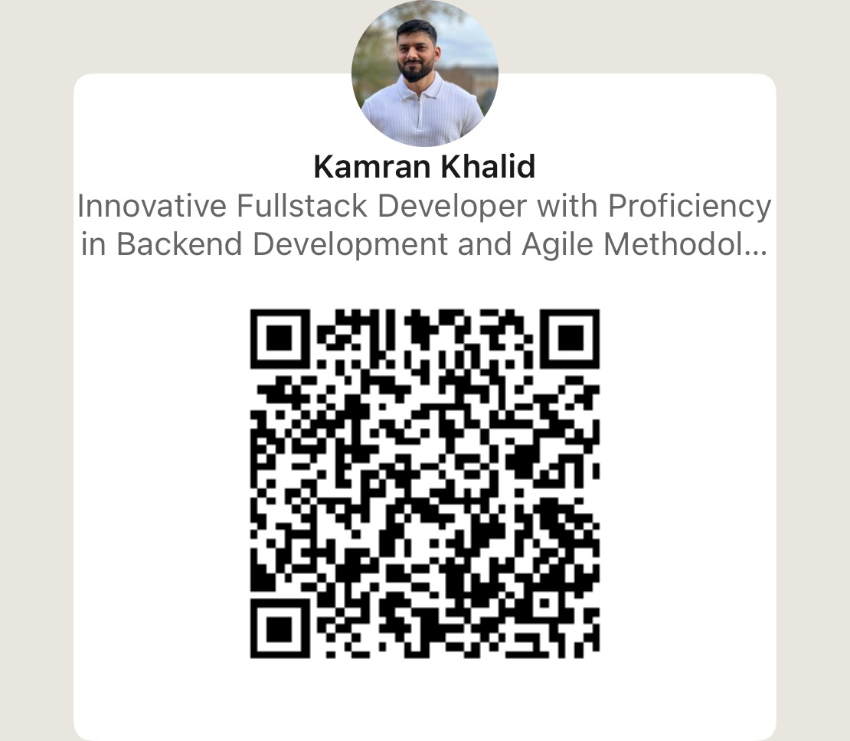
Thank You!

